Slide 1
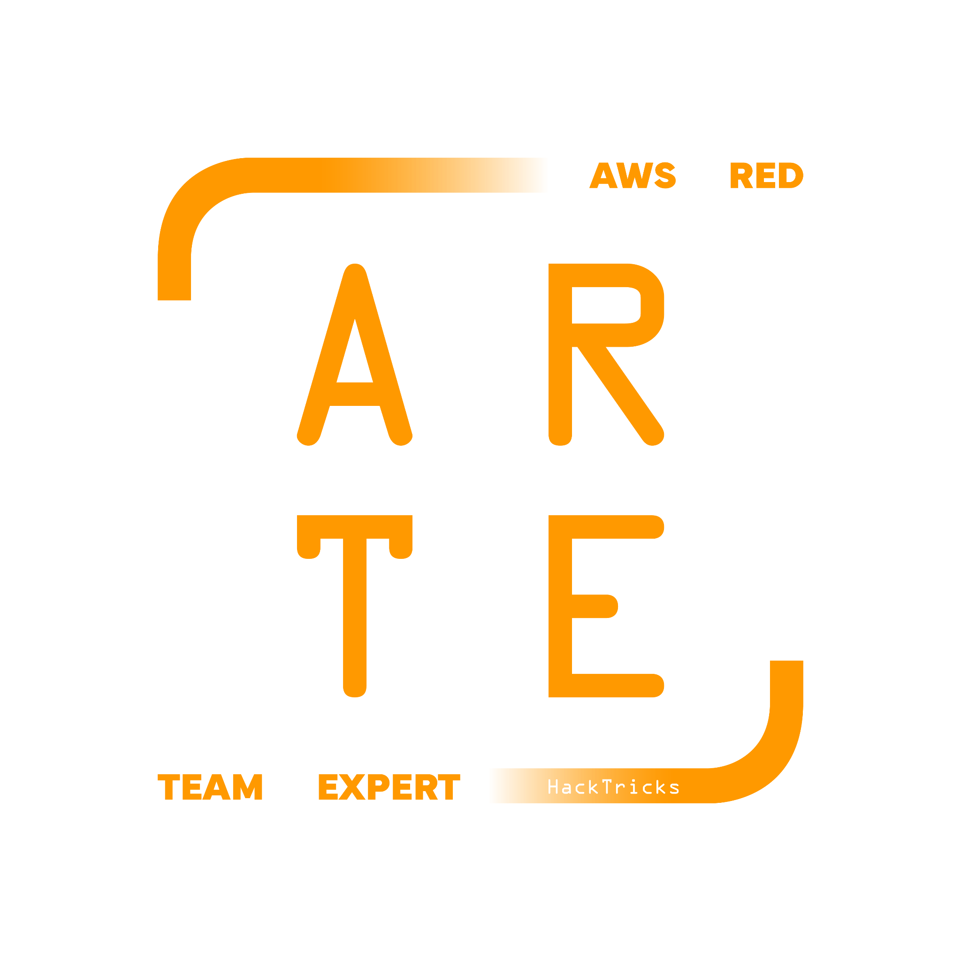
Elastic Beanstalk
HackTricks Training
https://t.me/CyberFreeCourses

Slide 2
Basic Information
Amazon Elastic Beanstalk is a fully managed service that makes it easy to deploy, run, and scale web applications and services developed with Java, .NET, PHP, Node.js, Python, Ruby, Go, Docker, Tomcat on familiar servers such as Apache, Nginx, Passenger, and IIS.
Elastic Beanstalk provides a simple and flexible way to deploy your applications to the AWS cloud, without the need to worry about the underlying infrastructure. It automatically handles the details of capacity provisioning, load balancing, scaling, and application health monitoring, allowing you to focus on writing and deploying your code.
The infrastructure created by Elastic Beanstalk is managed by Autoscaling Groups in EC2 (with a load balancer). Which means that at the end of the day, if you compromise the host, you should know about about EC2.
Moreover, if Docker is used, it’s possible to use ECS.
https://t.me/CyberFreeCourses
https://cloud.hacktricks.xyz/pentesting-cloud/aws-security/aws-services/aws-elastic-beanstalk-enum

Slide 3
Application
An application in Elastic Beanstalk is a logical container for your application's source code, environments, and configurations. It groups together different versions of your application code and allows you to manage them as a single entity.
When you create an application, you provide a name and description, but no resources are provisioned at this stage. It is simply a way to organize and manage your code and related resources.
You can have multiple application versions within an application. Each version corresponds to a specific release of your code, which can be deployed to one or more environments.
https://t.me/CyberFreeCourses
https://cloud.hacktricks.xyz/pentesting-cloud/aws-security/aws-services/aws-elastic-beanstalk-enum

Slide 4
Environment
An environment is a provisioned instance of your application running on AWS infrastructure. It is where your application code is deployed and executed. Elastic Beanstalk provisions the necessary resources (e.g., EC2 instances, load balancers, auto-scaling groups, databases) based on the environment configuration.
Each environment runs a single version of your application, and you can have multiple environments for different purposes, such as development, testing, staging, and production.
When you create an environment, you choose a platform (e.g., Java, .NET, Node.js, etc.) and an environment type (e.g., web server or worker). You can also customize the environment configuration to control various aspects of the infrastructure and application settings.
https://t.me/CyberFreeCourses
https://cloud.hacktricks.xyz/pentesting-cloud/aws-security/aws-services/aws-elastic-beanstalk-enum

Slide 5
Beanstalk environments
There are 2 types of Beanstalk environment:
Web Server Environment: It is designed to host and serve web applications and APIs. These applications typically handle incoming HTTP/HTTPS requests. The web server environment provisions resources such as EC2 instances, load balancers, and auto-scaling groups to handle incoming traffic, manage capacity, and ensure the application's high availability.
Worker Environment: It is designed to process background tasks, which are often time-consuming or resource-intensive operations that don't require immediate responses to clients. The worker environment provisions resources like EC2 instances and auto-scaling groups, but it doesn't have a load balancer since it doesn't handle HTTP/HTTPS requests directly. Instead, it consumes tasks from an Amazon Simple Queue Service (SQS) queue, which acts as a buffer between the worker environment and the tasks it processes.
https://t.me/CyberFreeCourses
https://cloud.hacktricks.xyz/pentesting-cloud/aws-security/aws-services/aws-elastic-beanstalk-enum

Slide 6
Security
In case of compromising the a Beanstalk environment you will probably be compromising the web environment via a web vulnerability. However, if could also be possible to compromise a worker environment exploiting an injection via a SQS message.
EC2 key pair: This will be the SSH key that will be able to access the EC2 instances running the app
IAM instance profile: This is the instance profile that the instances will have (IAM privileges)
The autogenerated role is called aws-elasticbeanstalk-ec2-role and has some interesting access over all ECS, all SQS, elasticbeanstalk DynamoDB tables and elasticbeanstalk S3 buckets using the AWS managed policies: AWSElasticBeanstalkWebTier, AWSElasticBeanstalkMulticontainerDocker, AWSElasticBeanstalkWorkerTier.
Service role: This is the role that the AWS service will use to perform all the needed actions. Afaik, we cannot access this role.
This role generated by AWS is called aws-elasticbeanstalk-service-role and uses the AWS managed policies AWSElasticBeanstalkEnhancedHealth and AWSElasticBeanstalkManagedUpdatesCustomerRolePolicy.
Beanstalk data is stored in a S3 bucket with the following name: elasticbeanstalk-<region>-<acc-id> (if it was created in the AWS console). Inside this bucket you will find the uploaded source code of the application.
The URL of the created webpage is https://<webapp-name>-env.<region>.elasticbeanstalk.com/
https://t.me/CyberFreeCourses
https://cloud.hacktricks.xyz/pentesting-cloud/aws-security/aws-services/aws-elastic-beanstalk-enum

Slide 7
Manual Enumeration
# Find S3 bucket
for r in us-east-1 us-east-2 us-west-1 us-west-2 ap-south-1 ap-south-2 ap-northeast-1 ap-northeast-2 ap-northeast-3 ap-southeast-1 ap-southeast-2 ap-southeast-3 ca-central-1 eu-central-1 eu-central-2 eu-west-1 eu-west-2 eu-west-3 eu-north-1 sa-east-1 af-south-1 ap-east-1 eu-south-1 eu-south-2 me-south-1 me-central-1; do aws s3 ls elasticbeanstalk-$r-<account_number> 2>/dev/null; done
# Get apps and URLs
aws elasticbeanstalk describe-applications # List apps
aws elasticbeanstalk describe-application-versions # Get apps & bucket name with source code
aws elasticbeanstalk describe-environments # List envs
aws elasticbeanstalk describe-environments | grep -E "EndpointURL|CNAME"
aws elasticbeanstalk describe-environment-resources --environment-name <name>
# Get events
aws elasticbeanstalk describe-events
https://t.me/CyberFreeCourses
https://cloud.hacktricks.xyz/pentesting-cloud/aws-security/aws-services/aws-elastic-beanstalk-enum

Slide 8
Unauth Access
Open EC2 instance via Security Groups
Publicly accessible Load balancer (web environments) or SQS queue (Worker environments)
Publicly accessible S3 bucket with source code
https://t.me/CyberFreeCourses
https://cloud.hacktricks.xyz/pentesting-cloud/aws-security/aws-unauthenticated-enum-access/aws-elastic-beanstalk-unauthenticated-enum

Slide 9
Privilege Escalation
elasticbeanstalk:CreateApplication, elasticbeanstalk:CreateEnvironment, elasticbeanstalk:CreateApplicationVersion, elasticbeanstalk:UpdateEnvironment, iam:PassRole, and more...
The mentioned plus several S3, EC2, cloudformation,autoscaling and elasticloadbalancing permissions are the necessary to create an Elastic Beanstalk application.
elasticbeanstalk:CreateApplicationVersion, elasticbeanstalk:UpdateEnvironment, cloudformation:GetTemplate, cloudformation:DescribeStackResources, cloudformation:DescribeStackResource, autoscaling:DescribeAutoScalingGroups, autoscaling:SuspendProcesses, autoscaling:SuspendProcesses
Update and environment to compromise it
https://t.me/CyberFreeCourses
https://cloud.hacktricks.xyz/pentesting-cloud/aws-security/aws-privilege-escalation/aws-codebuild-privesc

Slide 10
Post Exploitation
DEMO
elasticbeanstalk:DeleteApplicationVersion | elasticbeanstalk:TerminateEnvironment | elasticbeanstalk:DeleteApplication | elasticbeanstalk:SwapEnvironmentCNAMEs
Cause some kind of DoS
Find sensitive information in the source code
Modify elastic beanstalk source code in S3 bucket to compromise it
https://t.me/CyberFreeCourses
https://cloud.hacktricks.xyz/pentesting-cloud/aws-security/aws-post-exploitation/aws-elastic-beanstalk-post-exploitation
Notes:
# Enumeration
aws --profile myadmin elasticbeanstalk describe-applications
aws --profile myadmin elasticbeanstalk describe-application-versions
aws --profile myadmin elasticbeanstalk describe-environments
aws --profile myadmin elasticbeanstalk describe-environment-resources --environment-name HacktricksTraining-env
aws --profile myadmin elasticbeanstalk describe-environment-resources --environment-name HacktricksTrainingDocker-env
aws --profile myadmin elasticbeanstalk describe-configuration-settings --application-name HacktricksTraining --environment-name HacktricksTraining-env
aws --profile myadmin elasticbeanstalk describe-configuration-settings --application-name HacktricksTrainingDocker --environment-name HacktricksTrainingDocker-env
for r in us-east-1 us-east-2 us-west-1 us-west-2 ap-south-1 ap-south-2 ap-northeast-1 ap-northeast-2 ap-northeast-3 ap-southeast-1 ap-southeast-2 ap-southeast-3 ca-central-1 eu-central-1 eu-central-2 eu-west-1 eu-west-2 eu-west-3 eu-north-1 sa-east-1 af-south-1 ap-east-1 eu-south-1 eu-south-2 me-south-1 me-central-1; do aws --profile myadmin s3 ls "elasticbeanstalk-$r-947247140022" 2>/dev/null && echo "Found in: elasticbeanstalk-$r-947247140022"; done
# Metadata EC2
ssh -i beanstalk.pem ec2-user@54.72.245.197
cd /tmp
./linpeas.sh -o cloud
docker ps
# Metadata EC2 + ECS
ssh -i beanstalk.pem ec2-user@54.228.214.155
cd /tmp
./linpeas.sh -o cloud
sudo su
docker ps
docker exec -it 2c5ceb510fc7 bash
cd /tmp
./linpeas.sh -o cloud
env
# Inject in elasticbeanstalk
mkdir elasticbeanstalk-eu-west-1-947247140022
cd elasticbeanstalk-eu-west-1-947247140022
aws --profile myadmin s3 sync s3://elasticbeanstalk-eu-west-1-947247140022 .
### change code
aws --profile myadmin s3 cp 1692777270420-aws-flask-app.zip s3://elasticbeanstalk-eu-west-1-947247140022/1692777270420-aws-flask-app.zip
aws --profile myadmin elasticbeanstalk rebuild-environment --environment-name "FlaskTest-env"

